Slide 1
NETWORK PROGRAMMING · UTM
Concurrent programming
and multithreading
Lecture #1 · Ernest Bîtca
Notes:
Title slide. Course line, lecture title, lecture number. Keep the title to one line if you can — two lines maximum.

Slide 2
"Some people, when confronted with a problem, think 'I know, I'll use multithreading.' Now they have two problems."
Notes:
Section divider. Use one before every major part of the lecture so students know where they are.

Slide 3
AGENDA
What we'll cover
00
01
02
From single to multi threading
Concurrency vs parallelism
Threads. Code examples.
Network Programming · Lecture 1
Notes:
Agenda. Three to four numbered columns. One short phrase each — do not write sentences here.

Slide 4
INTRODUCTION
The free lunch
From roughly 1975 to 2004, a programmer could make slow code fast by doing nothing at all. Clock frequencies rose from a few megahertz to nearly four gigahertz, and the same unmodified single-threaded binary ran faster on each new generation of hardware. This was the free lunch.
Network Programming · Lecture 1
Notes:
Standard content slide: explanation left, diagram or screenshot right. Replace the placeholder box with a real image. Keep the left column under ~60 words.

Slide 5
INTRODUCTION
The problem
Faster clock -> more power -> more heat.
Around 2004 the heat became impossible to remove. Intel cancelled its 4 GHz Pentium 4. Clocks stopped at about 4 GHz. Today: still ~5 GHz. New plan: not a faster CPU, but MORE CPUs (cores). Now the programmer must write concurrent code to get the speed.
Network Programming · Lecture 1
Notes:
Standard content slide: explanation left, diagram or screenshot right. Replace the placeholder box with a real image. Keep the left column under ~60 words.

Slide 6
INTRODUCTION
Hyper Threading
A CPU core is like a worker at a desk. Normally it handles one task at a time. But that worker often sits idle for tiny moments — waiting for data to arrive from memory, for example.
Hyperthreading gives that one worker two inboxes instead of one. When task A is stuck waiting, the core immediately switches to task B instead of doing nothing. In practice it's usually a 15–30% gain, and it helps most when you're running many things at once. If a single program is already keeping the core fully busy, hyperthreading adds almost nothing.
Network Programming · Lecture 1
Notes:
Standard content slide: explanation left, diagram or screenshot right. Replace the placeholder box with a real image. Keep the left column under ~60 words.

Slide 7
INTRODUCTION
Multi core
If hyperthreading is one worker with two inboxes, multi-core is several real workers, each with their own desk.
A 4-core processor has literally four complete computing units. Each one can run a different program at the same moment - genuinely in parallel, not by switching back and forth quickly. This is where you can actually approach 4x the work done. The difference from hyperthreading: there, you were filling in the idle gaps of a single worker. Here, you're hiring more workers.
Network Programming · Lecture 1
Notes:
Standard content slide: explanation left, diagram or screenshot right. Replace the placeholder box with a real image. Keep the left column under ~60 words.

Slide 8
CONCURRENCY
Dealing with many things at once
Notes:
Section divider. Use one before every major part of the lecture so students know where they are.

Slide 9
PARALLELISM
Doing many things at once
Notes:
Section divider. Use one before every major part of the lecture so students know where they are.

Slide 10
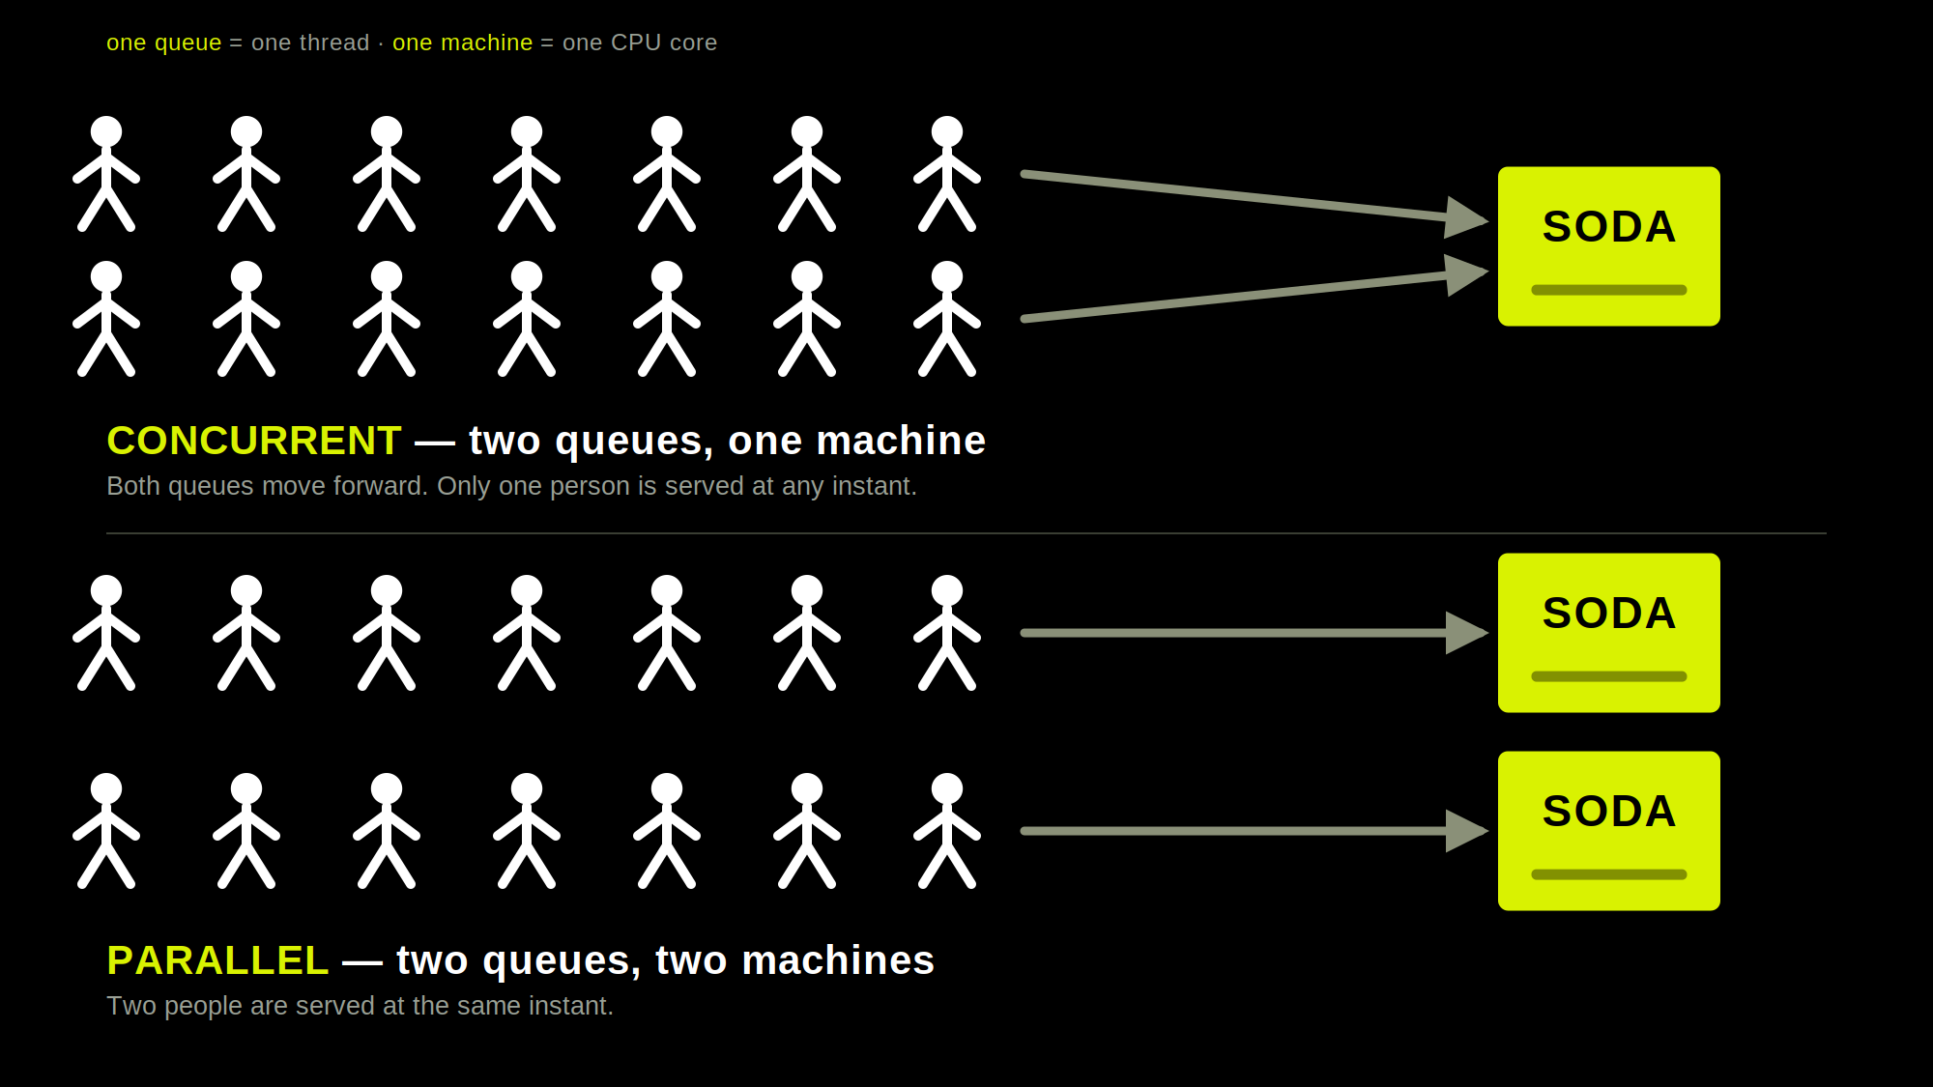
Notes:
Section divider. Use one before every major part of the lecture so students know where they are.

Slide 11
CONCEPT
Concurrency
Concurrency is a key aspect of beautiful software. For decades, concurrency was possible but difficult to achieve. Concurrent software was difficult to write, difficult to debug, and difficult to maintain. As a result, many developers chose the easier path and avoided concurrency. With the libraries and language features available for modern .NET programs, concurrency is now much easier. End-user applications use concurrency to respond to user input while writing to a database. Server applications use concurrency to respond to a second request while finishing the first request. You need concurrency any time you need an application to do one thing while it’s working on something else. Almost every software application in the world can benefit from concurrency.
Network Programming · Lecture 1
Notes:
Standard content slide: explanation left, diagram or screenshot right. Replace the placeholder box with a real image. Keep the left column under ~60 words.

Slide 12
Keywords
Keywords
Concurrency - doing more than one thing at a time.
Multithreading - a form of concurrency that uses multiple threads of execution.
Parallel processing - doing lots of work by dividing it up among multiple threads that run concurrently.
Asynchronous programming - A form of concurrency that uses futures or callbacks to avoid
unnecessary threads.
Network Programming · Lecture 1
Notes:
Standard content slide: explanation left, diagram or screenshot right. Replace the placeholder box with a real image. Keep the left column under ~60 words.

Slide 13
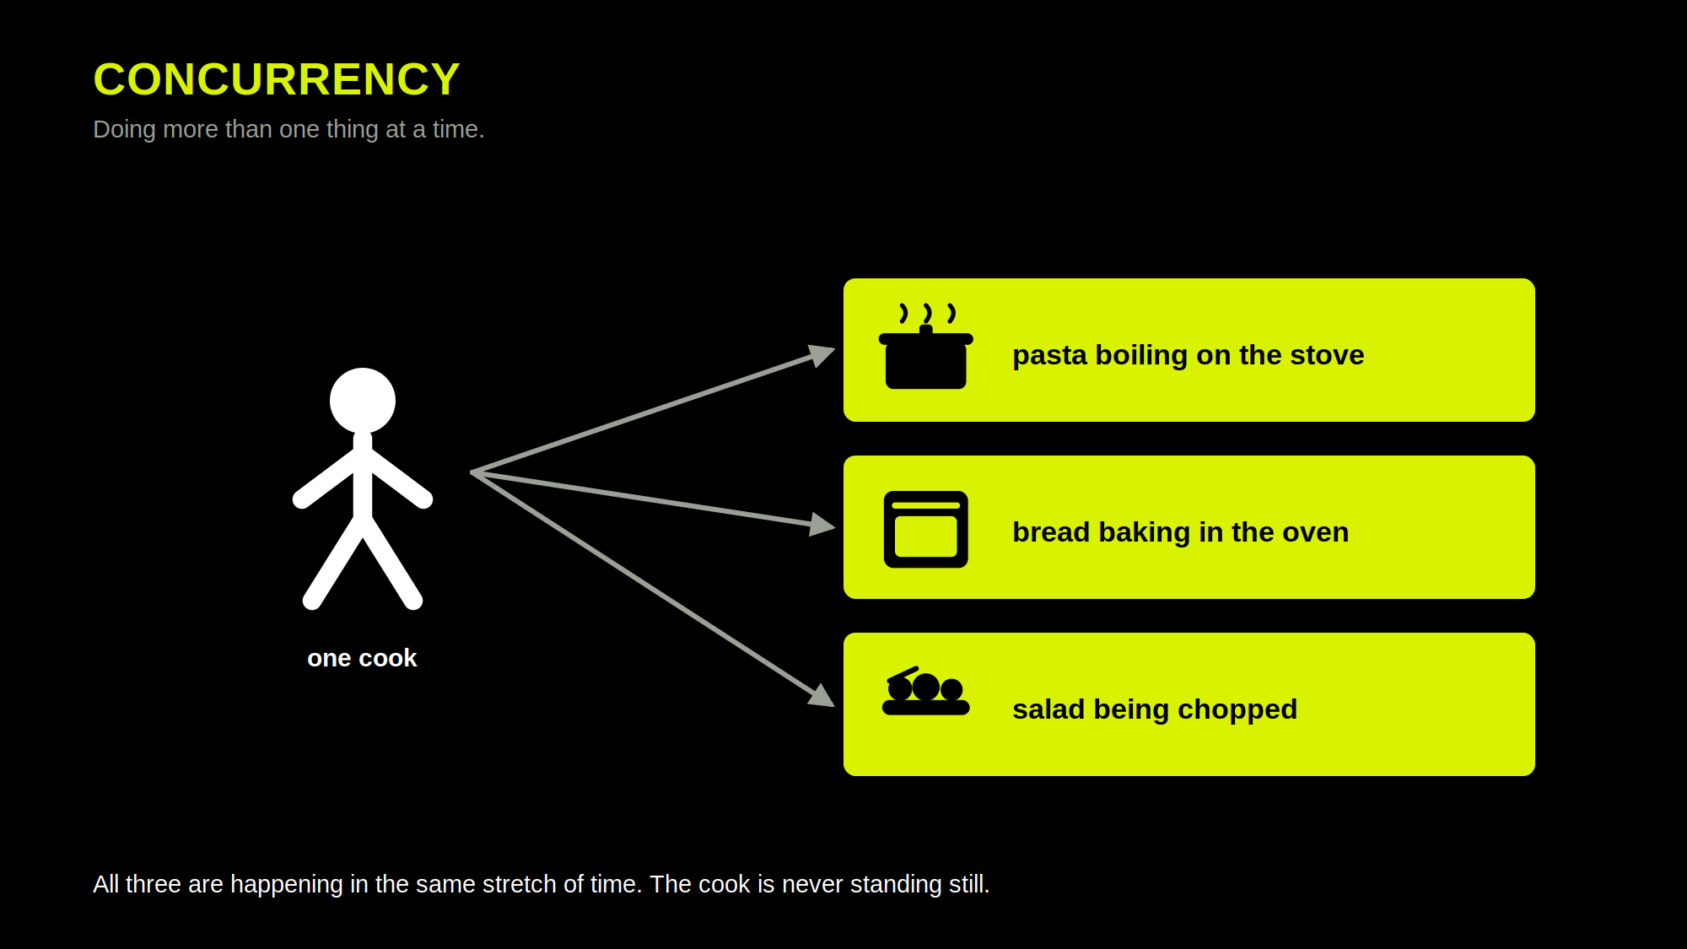
Network Programming · Lecture 1
Notes:
Standard content slide: explanation left, diagram or screenshot right. Replace the placeholder box with a real image. Keep the left column under ~60 words.

Slide 14
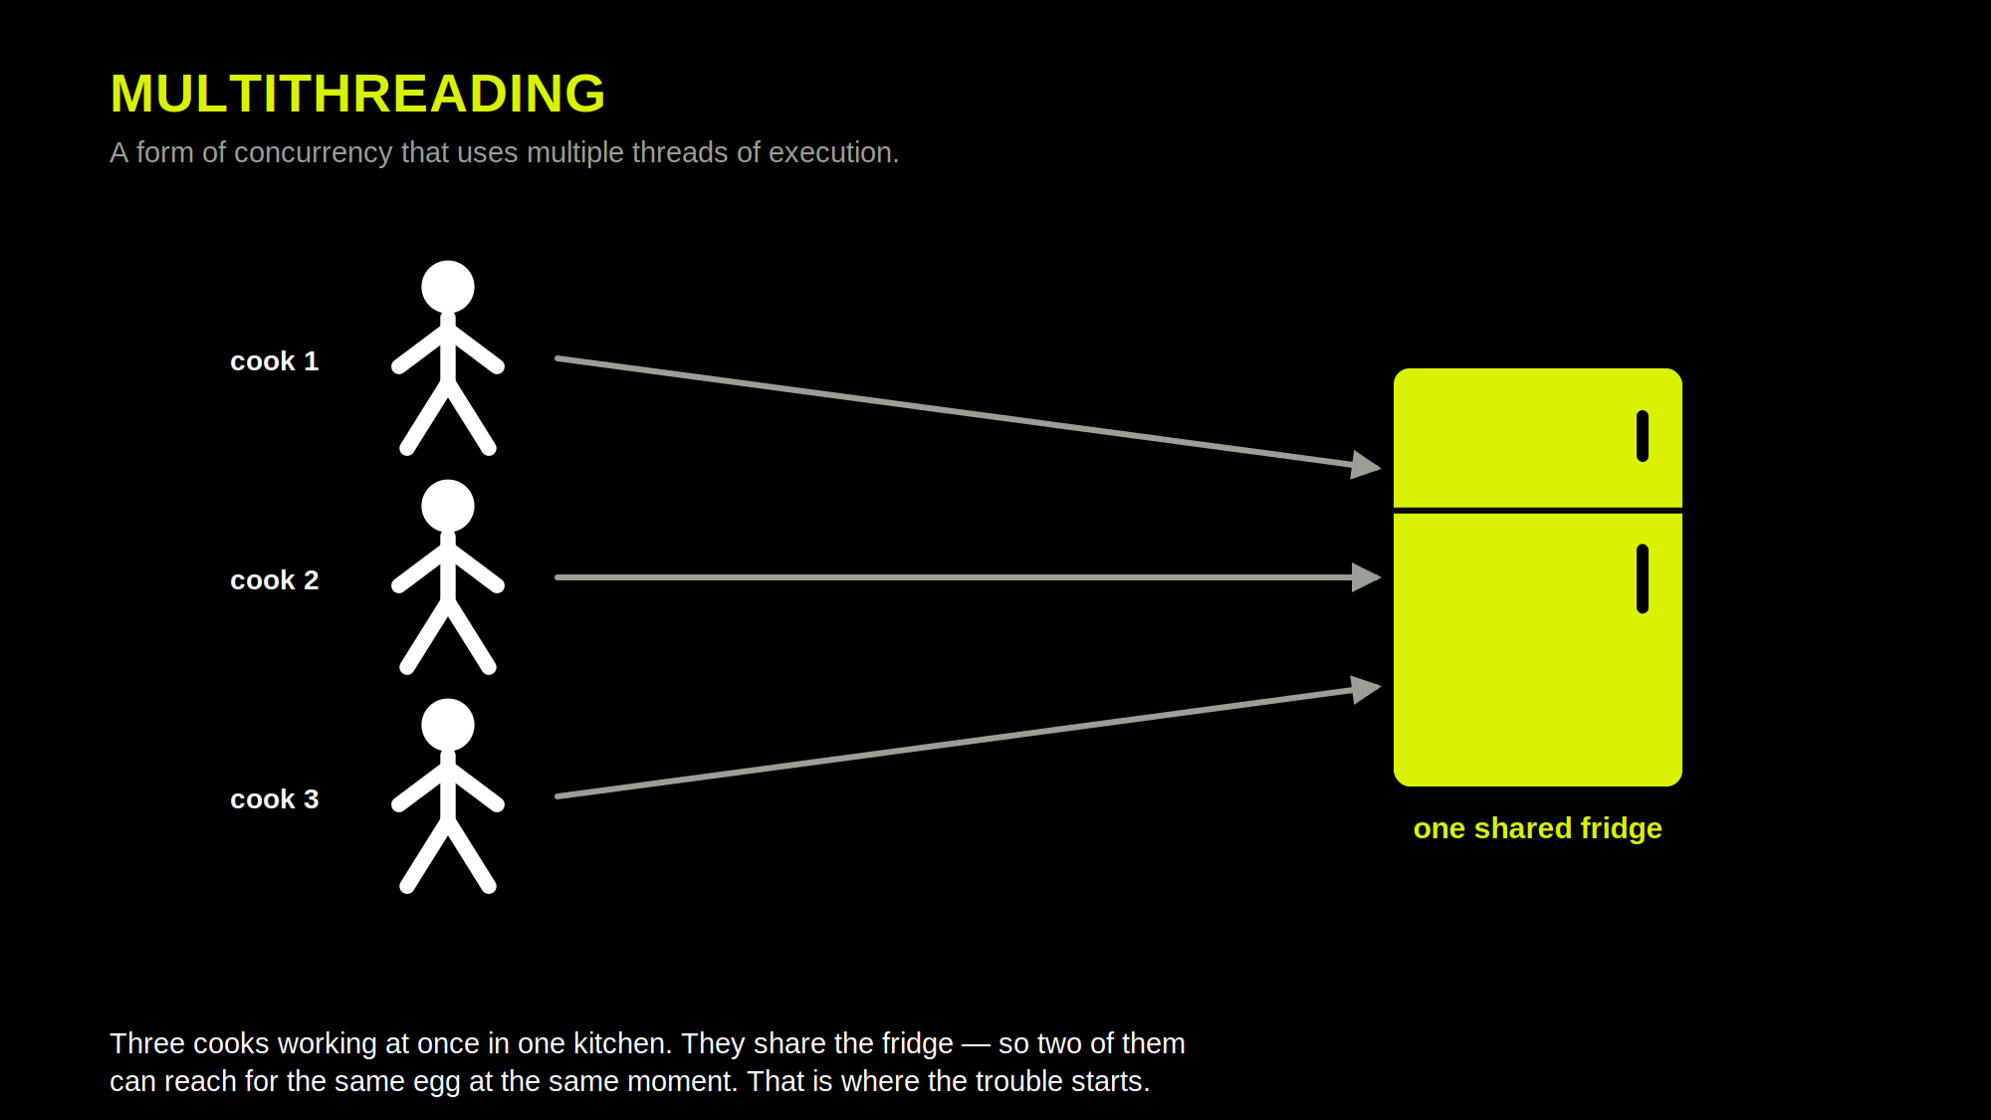
Network Programming · Lecture 1
Notes:
Standard content slide: explanation left, diagram or screenshot right. Replace the placeholder box with a real image. Keep the left column under ~60 words.

Slide 15
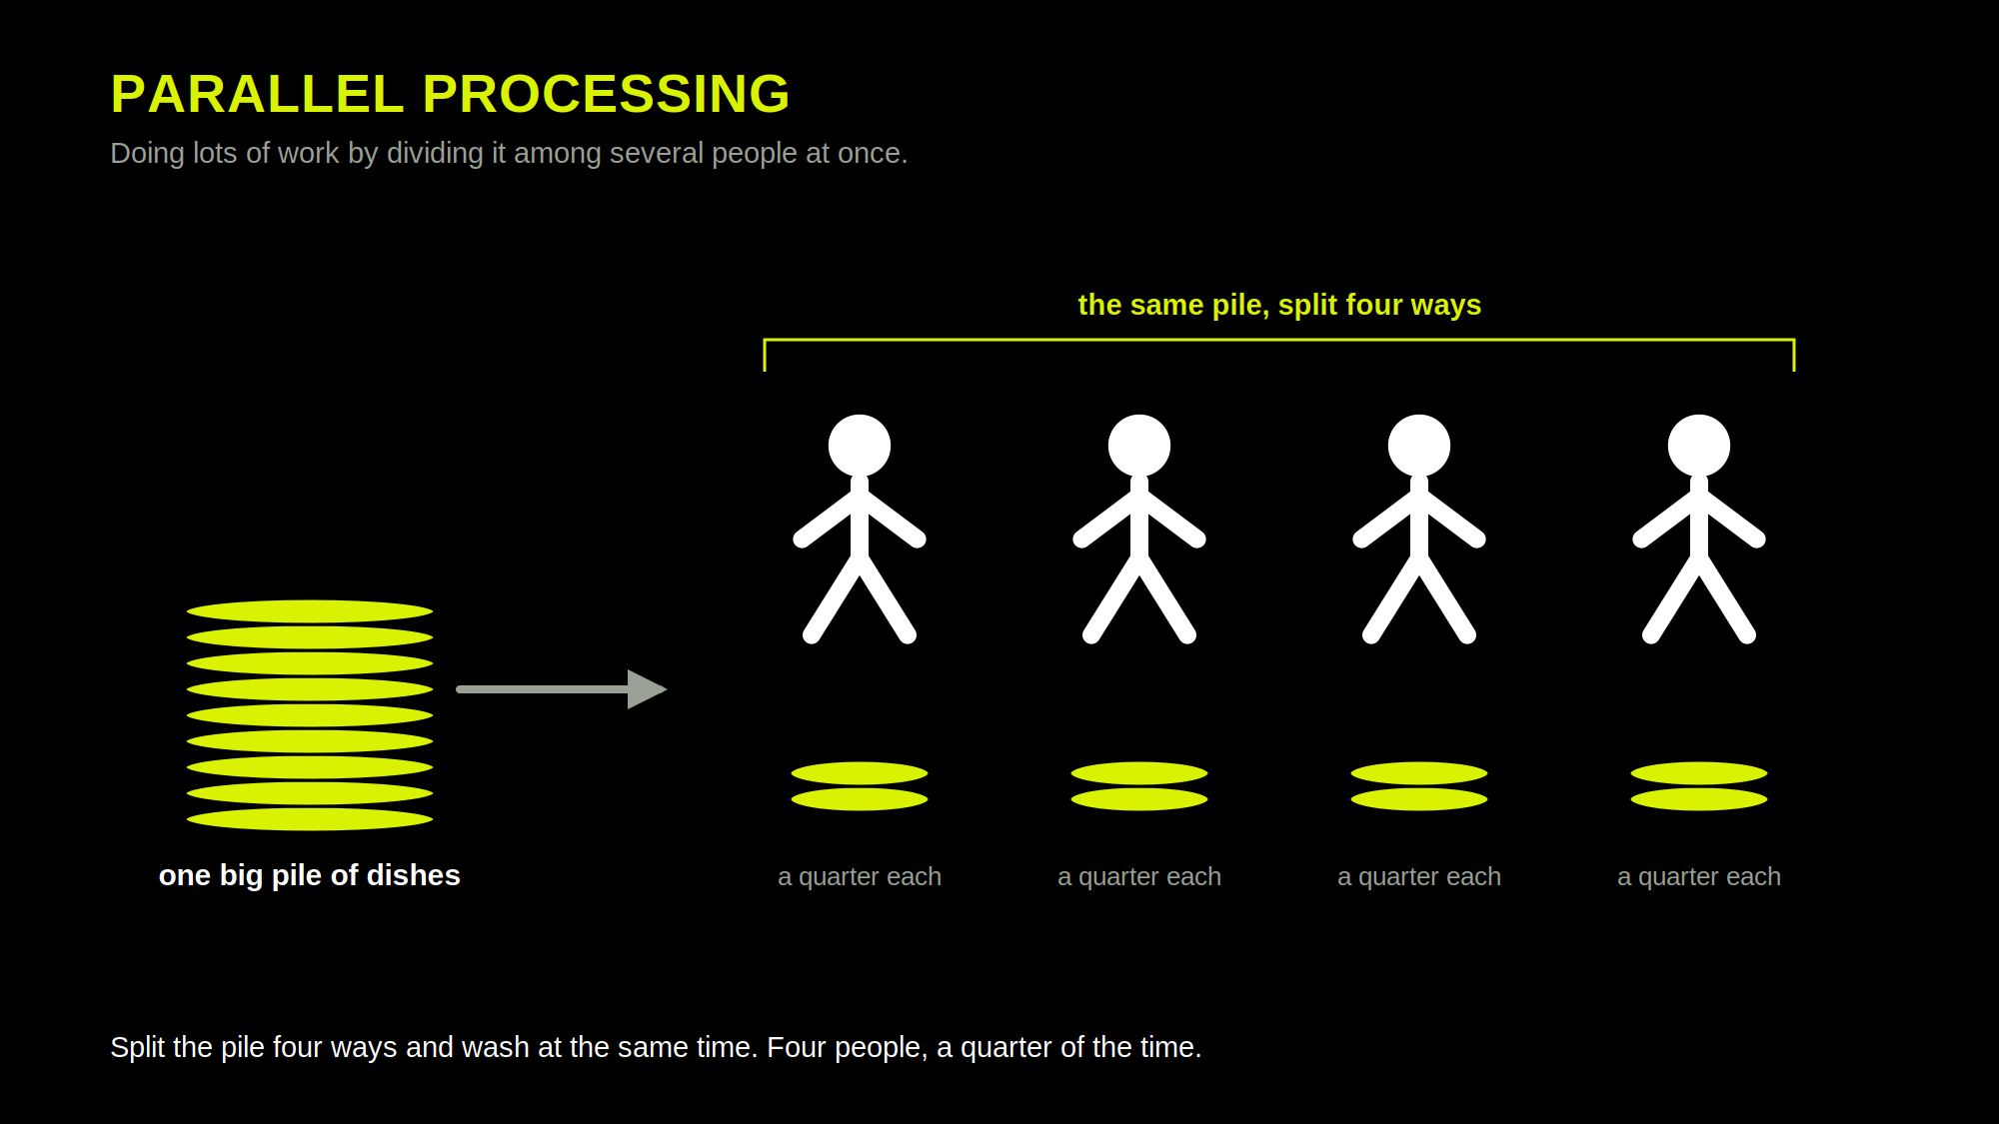
Network Programming · Lecture 1
Notes:
Standard content slide: explanation left, diagram or screenshot right. Replace the placeholder box with a real image. Keep the left column under ~60 words.

Slide 16
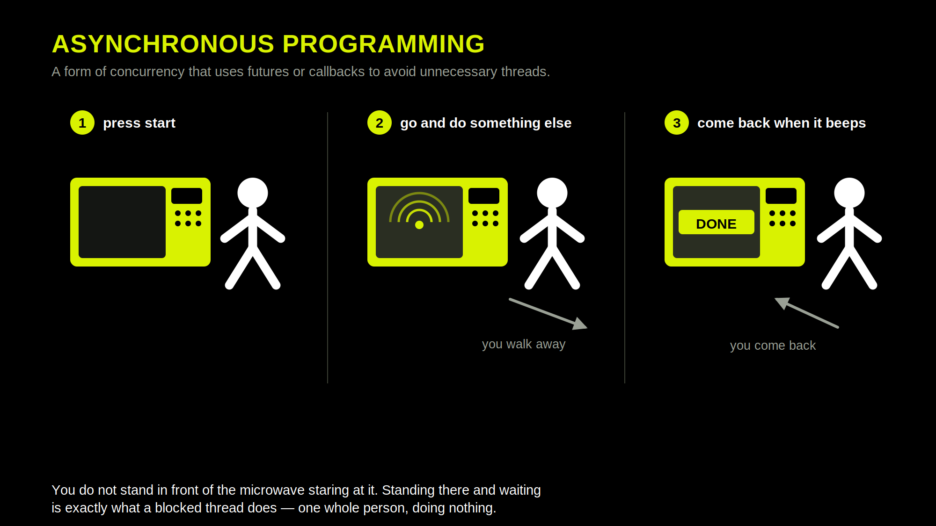
Network Programming · Lecture 1
Notes:
Standard content slide: explanation left, diagram or screenshot right. Replace the placeholder box with a real image. Keep the left column under ~60 words.

Slide 17
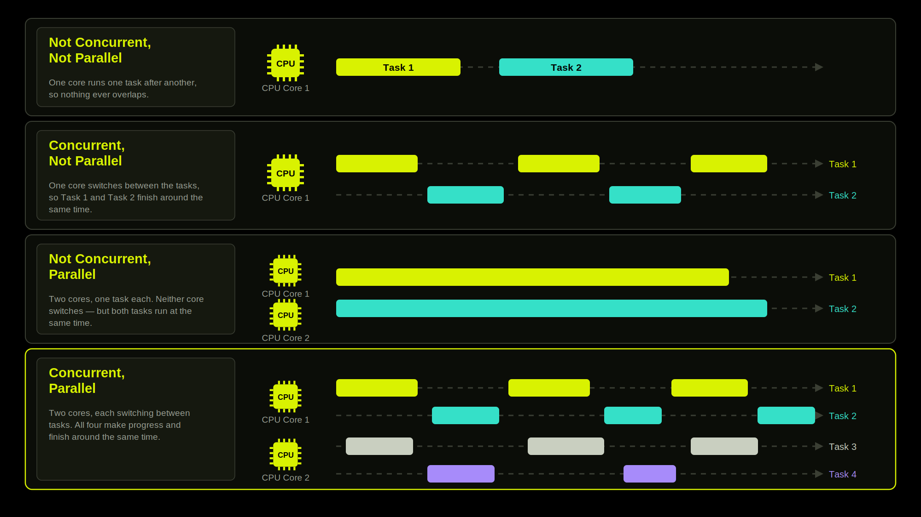
Network Programming · Lecture 1
Notes:
Standard content slide: explanation left, diagram or screenshot right. Replace the placeholder box with a real image. Keep the left column under ~60 words.

Slide 18
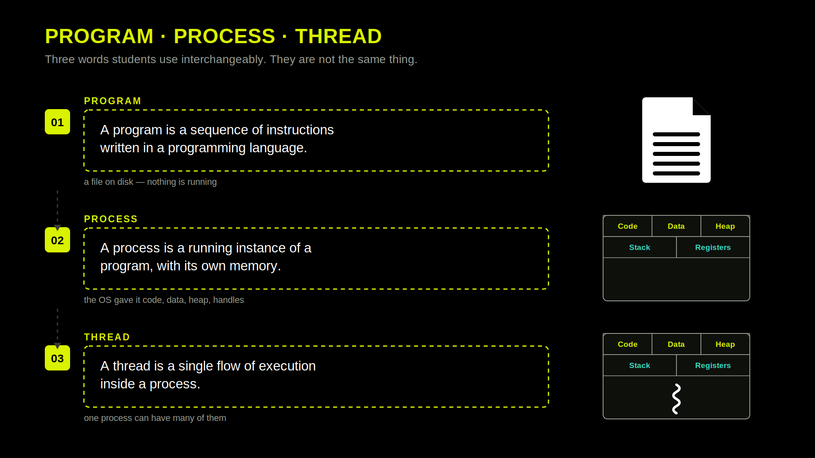

Slide 19
PROCESS vs THREAD
Process vs Thread
A process owns the resources: a private virtual address space, the open file and socket handles, and at least one thread.
A thread is the unit of scheduling: a program counter, a set of registers, and its own stack. Threads in one process share the heap, static fields and all handles. They do not share stacks. Local variables belong to one thread alone.
Network Programming · Lecture 1
Notes:
Standard content slide: explanation left, diagram or screenshot right. Replace the placeholder box with a real image. Keep the left column under ~60 words.

Slide 20
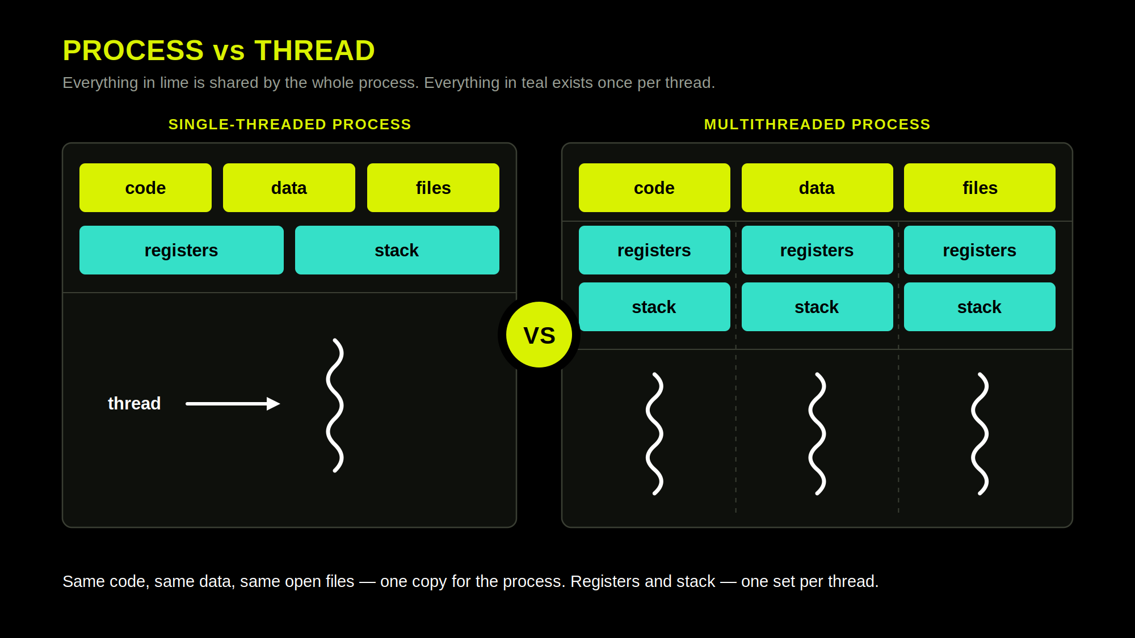
Network Programming · Lecture 1
Notes:
Standard content slide: explanation left, diagram or screenshot right. Replace the placeholder box with a real image. Keep the left column under ~60 words.

Slide 21
More on threads
CPU Threads vs Software Threads
CPU threads are hardware constructs, while software threads are code-level abstractions.At its core, a CPU thread (hardware thread) represents a physical or logical execution slot provided by the processor to run instructions. A software thread is a sequence of instructions created by code and managed by the operating system (OS) or a programming language runtime to perform specific tasks
Network Programming · Lecture 1
Notes:
Standard content slide: explanation left, diagram or screenshot right. Replace the placeholder box with a real image. Keep the left column under ~60 words.

Slide 22
C# · EXAMPLE 1
Creating a thread
// 1. describe the work
Thread worker = new Thread(Work);
// 2. start it - now two threads run
worker.Start();
// 3. wait for it to finish
worker.Join();
void Work() // executed on different thread
{
int id = Thread.CurrentThread.ManagedThreadId;
Console.WriteLine($"[worker] thread {id}");
}
Start() creates the thread. Join() makes main wait for it.
Network Programming · Lecture 1

Slide 23
REPOSITORY
More examples in code
Module 1 - Multithreading
one class per example, all implementing IExample - pick one in Program.cs
01 Hello, thread
02 Two infinite loops: A and B
03 Start order is not guaranteed
04 Passing data into a thread
05 Foreground vs background
06 Sorting two arrays at once
07 Sequential vs parallel
08 Counting primes with N threads
09 What a thousand threads cost
10 CPU-bound vs I/O-bound
Network Programming · Lecture 1

Slide 24
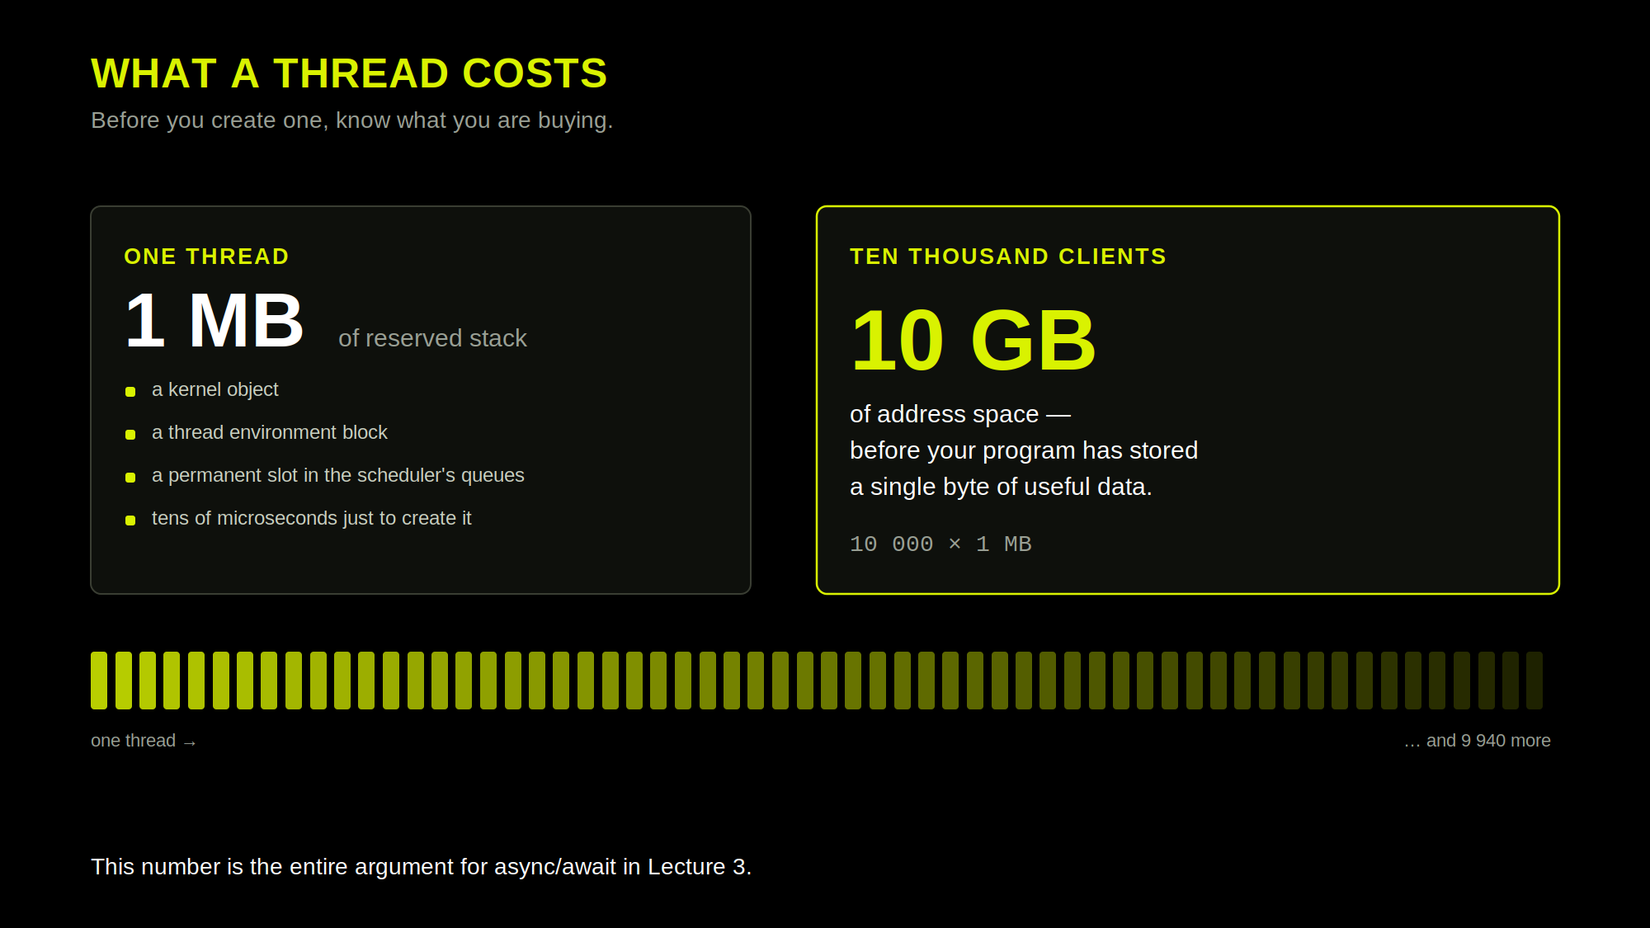
Network Programming · Lecture 1
Notes:
Standard content slide: explanation left, diagram or screenshot right. Replace the placeholder box with a real image. Keep the left column under ~60 words.

Slide 25
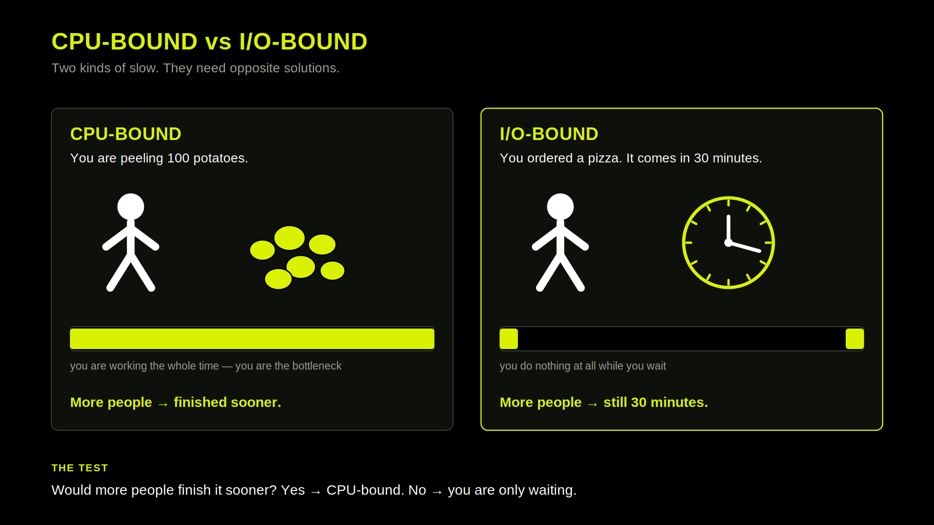

Slide 26
DEFINITION
CPU-bound and I/O-bound
CPU-BOUND
I/O-BOUND
A program is CPU-bound when its speed is limited by the power of the central processing unit.
What it means: The processor is constantly working and doing heavy computations.
Behavior: Low idle time, high processor usage, and long calculation bursts.
Examples: Video encoding, image processing, game physics, and encryption.
How to speed it up: Use multi-core processors, parallel programming, or faster hardware.
I/O-bound program is limited by the time it spends waiting for external input and output operations.
What it means: The program spends most of its time waiting for data to arrive from external sources.
Behavior: Low processor usage and long periods in a waiting state.
Examples: Reading files from a disk, database queries, and network or API requests.
How to speed it up: Use asynchronous programming, concurrency, and caching.
Network Programming · Lecture 1

Slide 27
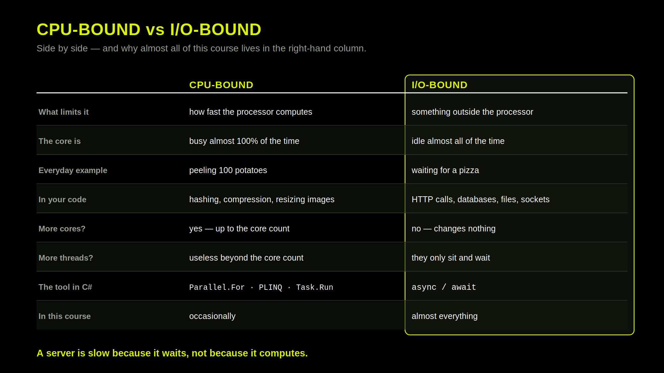

Slide 28
Thank you for your attention
Questions?

